Slide 1
Front End Engineering-I Project
Team Details:
Khushleen Kaur Sekhon 2310992040
Kirtan Singla 2310992041
Komal 2310992042
Faculty Coordinator : MR. DEEPAK KUMAR
:
Chitkara University Institute of Engineering and Technology,
Chitkara University, Punjab

Slide 2
Table of Contents
Introduction
Problem Statement
Technical Details
Key Features
Project Highlights
Conclusion
References/Links used

Slide 3
Introduction
Job Onbard
(by: Khushleen Kaur Sekhon, Kirtan Singla, Komal)
The website is made under the guidance of our Front End Engineering Professor Mr. Deepak Raheja who has helped us the idea and making of the website page.
The purpose of this project report is to evolve the landscape of career opportunities, finding the right job and the perfect candidate. In this era of unemployment, a job board platform is a boost to people’s career.
Our moto is to provide jobs which includes job security and great location to deserving candidates. Our platform not only addresses the challenges faced by job seekers in finding suitable employment opportunities but also simplifies the hiring process for employers, allowing them to identify the right talent quickly and effectively

Slide 4
Problem Statement
The current job market is plagued by inefficiencies and challenges that hinder both job seekers and employers. Job seekers often face difficulty in finding relevant job opportunities that match their skills and preferences, leading to frustration and wasted time. On the other hand, employers struggle to identify and attract the right candidates for their job openings, resulting in prolonged vacancies and productivity losses.
Furthermore, the job market is constantly evolving, with new industries and job roles emerging regularly. Existing job board platforms struggle to keep pace with these changes, resulting in a gap between the skills employers seek and the skills job seekers possess. Bridging this gap is essential for fostering a dynamic and competitive job market.

Slide 5
Technical Details
Minimum software required Minimum Hardware required
Parameters | Software
Design tool | VS Code
Language | HTML and CSS
Development Platform | Windows 10
Requirements | Specification
Processor | Intel core i3
RAM | 4GB
HDD | 1TB

Slide 6
Key Features
The key features used in the project are:
1)User registration and profiles
2)Job search and filters
3)Job listings and descriptions
4)Application management
5)Resume and document management
6)Company profiles
7)Communication tools
8)Career resources and support
9)Responsive design
10)Analytics and reporting

Slide 7
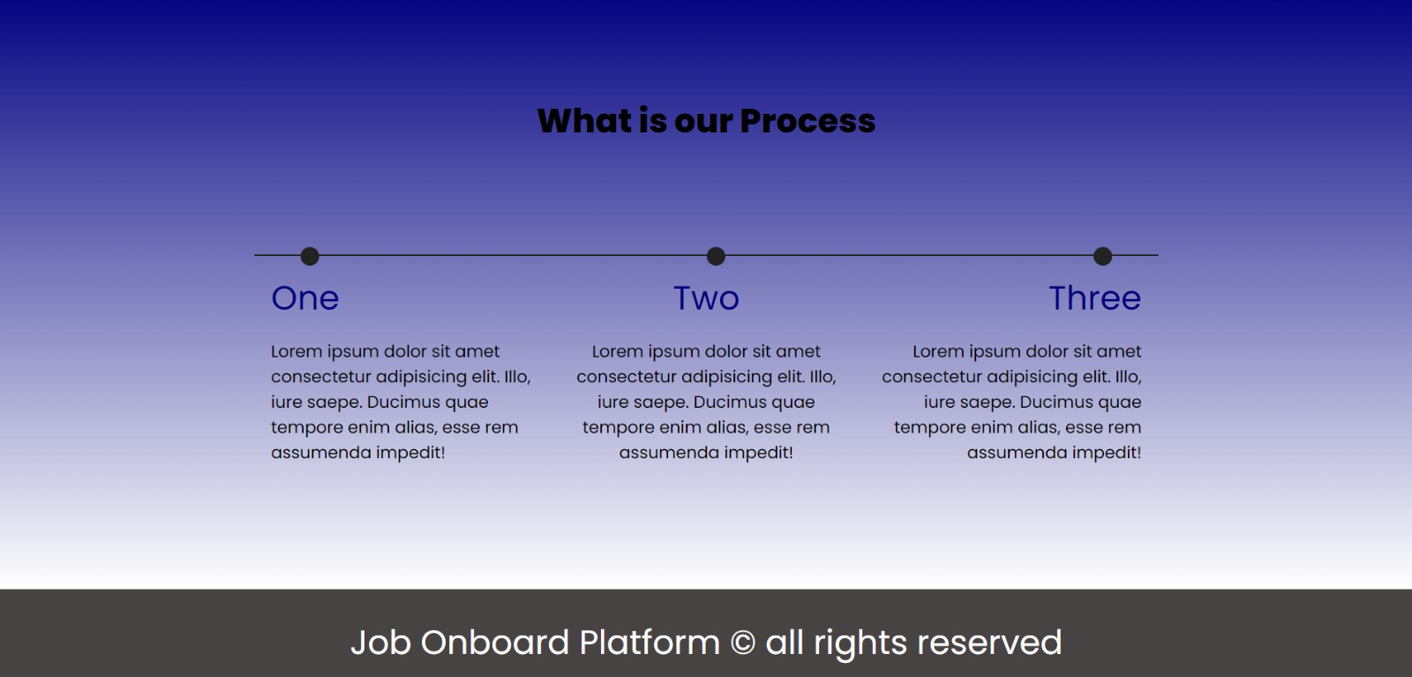
Project Highlights
This slide followed by many slides include the relevant screenshots of the running project and their corresponding code snippets.
FRONTPAGE:

Slide 8
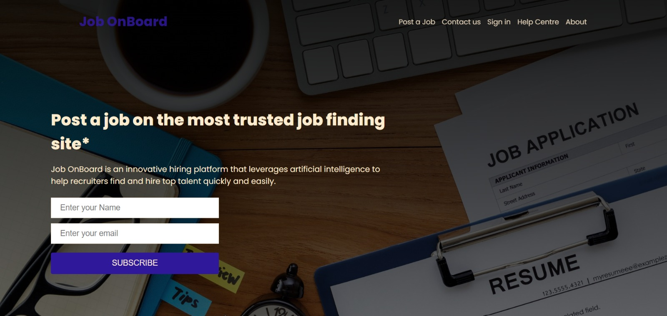

Slide 9
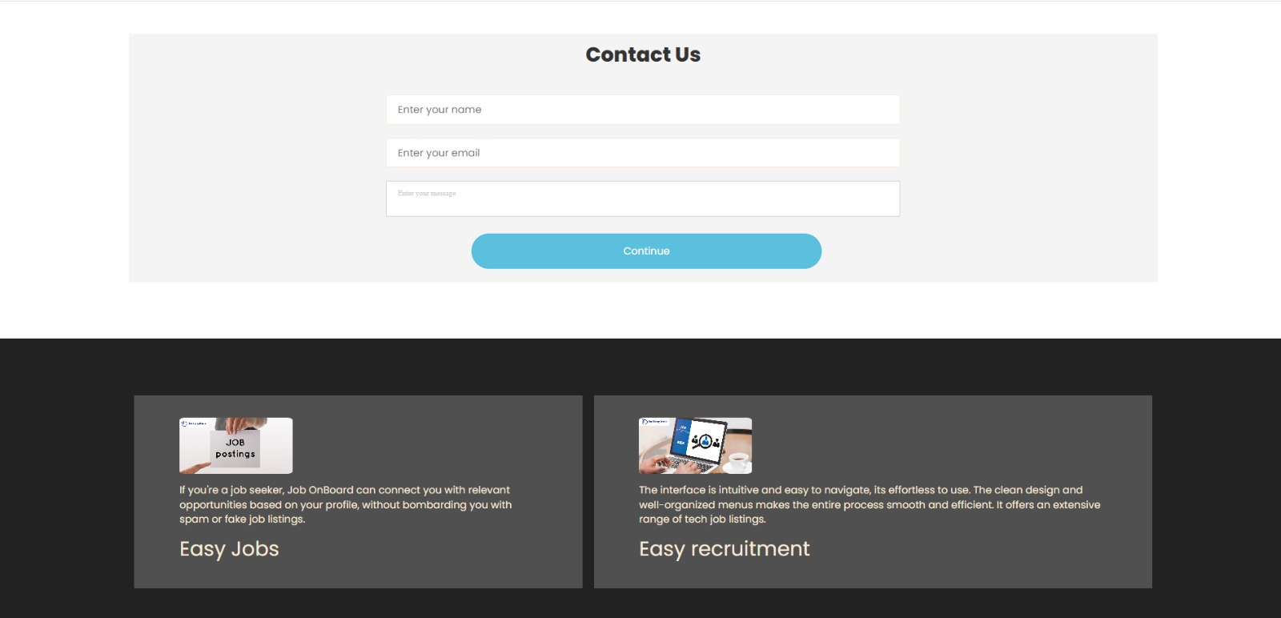

Slide 10
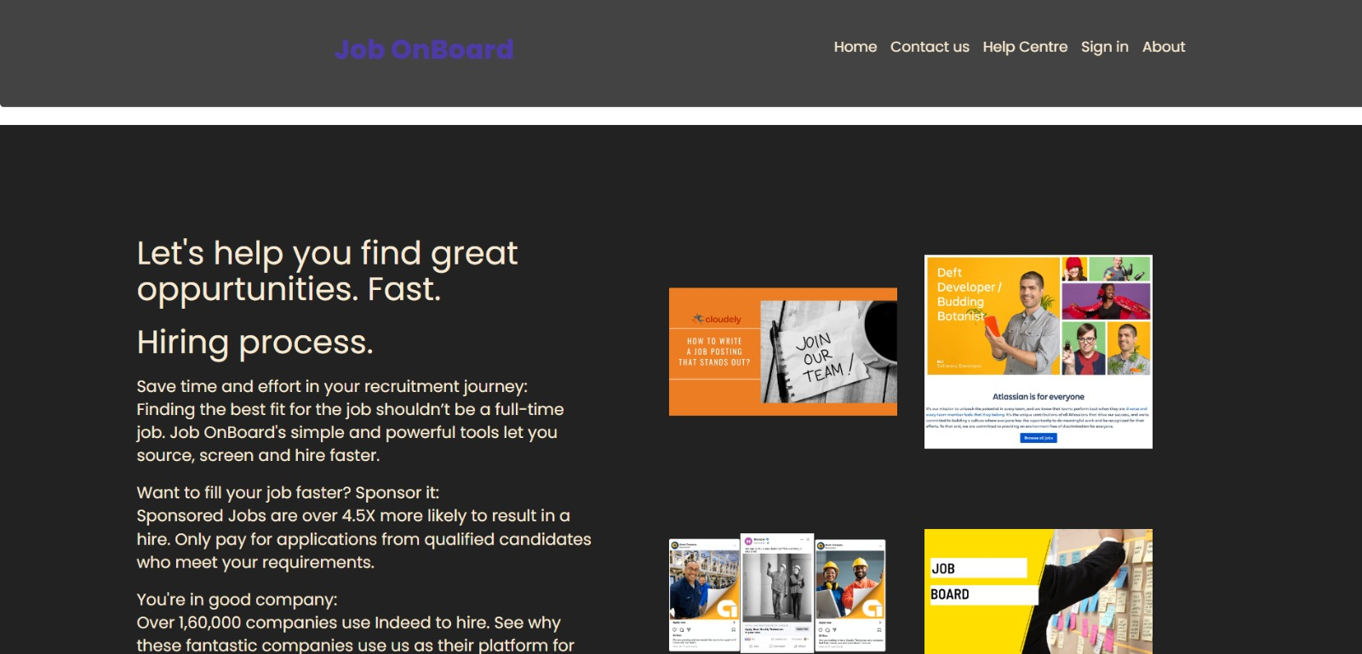
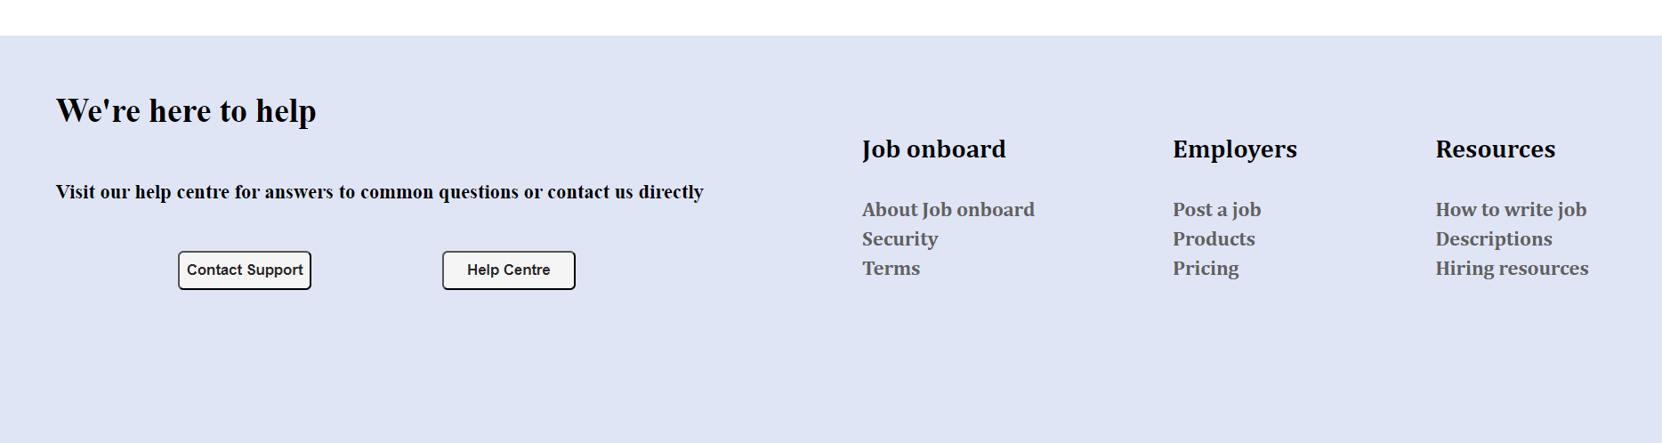

Slide 11
Similarly, other pages such as About us, security, terms, products, resources, descriptions, Pricing etc are made in same format.
The link to the website is attached below
file:///C:/Users/ACER/Desktop/ST1%20FEE/frontpage.html

Slide 12
Conclusion
The website is capable for searching cvs, resumes, jobs and candidates.
We have used tags of html and css. This job board platform helps give employment to people which also boosts the country’s economy.
In summary, our job board platform stands as a testament to the power of technology in transforming the way we connect with employment opportunities.

Slide 13
References/Links used
References
1) www.monster.com
2) www.g2.com
3) www.betterteam.com
4) www.smartjobboard.com
5) fountit.in

Slide 14


